Slide 1
JavaScript and jQuery Basics
Narendran R

Slide 2
JavaScript
JavaScript is a scripting language (a scripting language is a lightweight programming language)
JavaScript was designed to add interactivity to HTML pages
A JavaScript consists of lines of executable computer code
A JavaScript is usually embedded directly into HTML pages
JavaScript is an interpreted language (means that scripts execute without preliminary compilation)
Everyone can use JavaScript without purchasing a license

Slide 3
JavaScript History, Variations & Relationship to Java
Developed by Brendan Eich at Netscape
Scripting language for Navigator 2
Related to Java in name only
Name was part of a marketing deal
JavaScript, Jscript, ActionScript are implementations of ECMAScript maintained by W3C.

Slide 4
JavaScript Language Elements
Variables
Literals
Operators
Control Structures
Functions
Objects

Slide 5
Variables & Literals
Variables are declared with the magic word ‘var’.
var num = 10;
var name = ‘john’ or “john”;
var b = true;
var arr = new Array(n);
Literals include
Numbers 17 123.45
Strings "Hello Dave"
Boolean: true false
Arrays: [1,"Hi Dave",17.234]
Special Values
null
undefined

Slide 6
Operators
Arithmetic, comparison, assignment, bitwise, boolean (pretty much just like C++).
+ - * / % ++ -- == != > <
&& || ! & | << >>

Slide 7
Control Structures
Pretty much just like C:
if if-else ?: switch
for while do-while
And a few not in C
for (var in object)
with (object)

Slide 8
JavaScript Functions
The keyword function is used to define a function.
function add(x,y) {
return(x+y);
}
No type is specified for arguments!

Slide 9
JavaScript Objects
Objects have attributes and methods.
Many pre-defined objects are available,
Window object (via DOM)
Document object (via DOM)
Date object
Math object
Using objects follows the syntax:
objectname.attributename
objectname.methodname()

Slide 10
Handling Errors
JavaScript errors can be handled using the traditional way,
try
catch
finally
throw

Slide 11
More about Functions
Anonymous functions
Simulating a class
Timer functions and callbacks

Slide 12
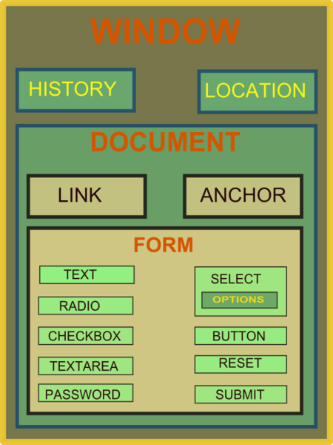
DOM scripting
What is DOM (Document Object Model)?
“The Document Object Model (DOM) is a cross-platform and language-independent convention for representing and interacting with objects in HTML, XHTML and XML documents. Aspects of the DOM (such as its "Elements") may be addressed and manipulated within the syntax of the programming language in use.”
What does DOM scripting involve?
Event Handling
Structure/Content Manipulation
Traversing the DOM tree.

Slide 13
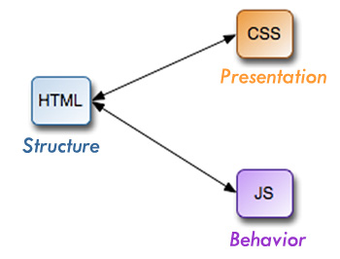
Responsibilities of resources

Slide 14
DOM Tree
A sample html document,
<html>
<head>
<meta name="viewport" content="width=device-width,initial-scale=1.0">
<link href="style.css" rel="stylesheet">
<title>Critical Path</title>
</head>
<body>
<p>Hello <span>web performance</span> students!</p>
<div><img src="awesome-photo.jpg"></div>
</body>
</html>

Slide 15
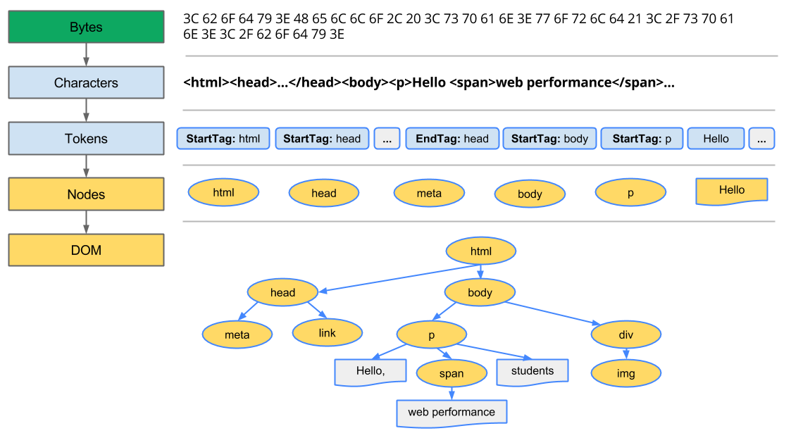
DOM Tree contd.

Slide 16
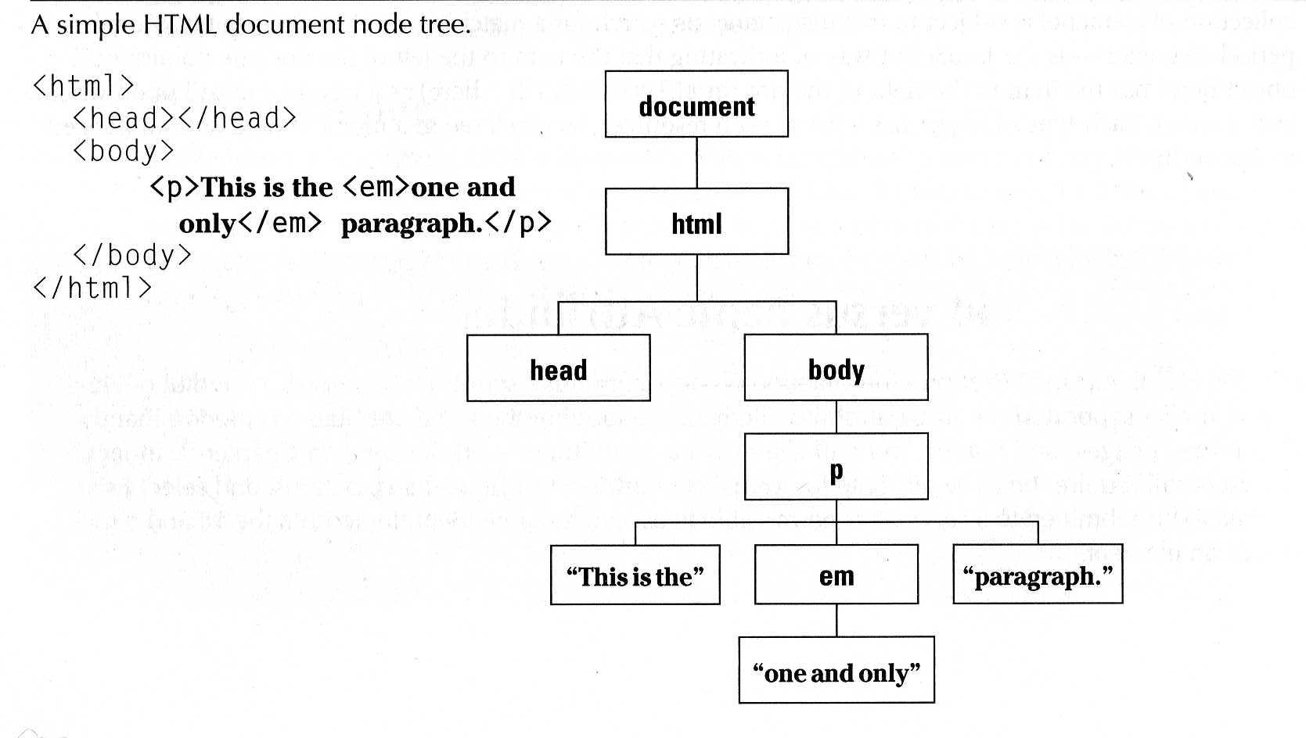
DOM Tree contd.

Slide 17
jQuery
Developed by John Resig at Rochester Institute of Technology
“jQuery is a lightweight JavaScript library that emphasizes interaction between JavaScript and HTML. It was released in January 2006 at BarCamp NYC by John Resig.”
“jQuery is free, open source software Dual-licensed under the MIT License and the GNU General Public License.”
How do I get it
www.jquery.com

Slide 18
What jQuery Does
“Unobtrusive” JavaScript – separation of behavior from structure
CSS – separation of style from structure
Advantages over just JavaScript
Much easier to use
Eliminates cross-browser problems
HTML to CSS to DHTML

Slide 19
More on what jQuery does..
Select DOM (Document Object Model) elements on a page – one element or a group of them
Set properties of DOM elements, in groups (“Find something, do something with it”)
Creates, deletes, shows, hides DOM elements
Defines event behavior on a page (click, mouse movement, dynamic styles, animations, dynamic content)
AJAX calls

Slide 20
jQuery Function
jQuery() = $()
$(function) The “Ready” handler
$(‘selector’) Element selector expression
$(element) Specify element(s) directly
$(‘HTML’) HTML creation
$.function() Execute a jQuery function
$.fn.myfunc(){} Create jQuery function

Slide 21
jQuery Ready / DOM Ready Function
jQuery(document).ready(function(){…};);
jQuery().ready(function(){…};)
jQuery(function(){…};)
jQuery(dofunc);
$(dofunc);

Slide 22
Selecting DOM elements - CSS Selectors
$(selector)
selector:
$(‘#id’) id of element
$(‘p’) tag name
$(‘.class’) CSS class
$(‘p.class’) <p> elements having the CSS class
$(‘p:first’) $(‘p:last’) $(‘p:odd’) $(‘p:even’)
$(‘p:eq(2)’) gets the 2nd <p> element (1 based)
$(‘p’)[1] gets the 2nd <p> element (0 based)
$(‘p:nth-child(3)) gets the 3rd <p> element of the parent. n=even, odd too.
$(‘p:nth-child(5n+1)’) gets the 1st element after every 5th one
$(‘p a’) <a> elements, descended from a <p>
$(‘p>a’) <a> elements, direct child of a <p>
$(‘p+a’) <a> elements, directly following a <p>
$(‘p, a’) <p> and <a> elements
$(‘li:has(ul)’) <li> elements that have at least one <ul> descendent
$(‘:not(p)’) all elements but <p> elements
$(‘p:hidden’) only <p> elements that are hidden
$(‘p:empty’) <p> elements that have no child elements

Slide 23
Selecting DOM elements contd.
$(‘img’[alt]) <img> elements having an alt attribute
$(‘a’[href^=http://]) <a> elements with an href attribute starting with ‘http://’
$(‘a’[href$=.pdf]) <a> elements with an href attribute ending with ‘.pdf’
$(‘a’[href*=ntpcug]) <a> elements with an href attriute containing ‘ntpcug’

Slide 24
DOM traversal and other useful functions
.each() iterate over the set
.size() number of elements in set
.end() reverts to the previous set
.get(n) get just the nth element (0 based)
.eq(n) get just the nth element (0 based) also .lt(n) & .gt(n)
.not(‘p’) don’t include ‘p’ elements in set
.add(‘p’) add <p> elements to set
.remove() removes all the elements from the page DOM
.empty() removes the contents of all the elements
.filter(fn/sel) selects elements where the func returns true or sel
.find(selector) selects elements meeting the selector criteria
.parent() returns the parent of each element in set
.children() returns all the children of each element in set
.next() gets next element of each element in set
.prev() gets previous element of each element in set
.siblings() gets all the siblings of the current element

Slide 25
Formatting DOM elements
.css(property, value)
.html()
.val() (form elements)
.text()
.addClass(‘class’)
.removeClass(‘class’)

Slide 26
Adding Content/DOM elements
$(‘#target’).before(‘<p>Inserted before #target</p>’);
$(‘#target’).after(‘<p>This is added after #target</p>’);
$(‘#target’).append(‘<p>Goes inside #target, at end</p>’);
$(‘#target’).prepend(‘<p>Goes inside #target, at the beginning</p>’);
$(‘#target’).wrap(‘<div></div>’);

Slide 27
Adding Behavior - Events
Events
Mouse events
Button events
Keystrokes
Event properties
event.target ref to element triggering event
event.target.id id of element triggering event
event.currentTarget
event.type type of event triggered
Various mouse coordinate properties
Various keystroke related properties
Event methods
.stopPropagation()
.preventDefault()
.trigger(eventType) does not actually trigger the event, but calls the appropriate function specified as the one tied to the eventType
.click(), blur(), focus(), select(), submit()
With no parameter, invokes the event handlers, like trigger does, for all the elements in the wrapped set

Slide 28
AJAX
Asynchronous JavaScript and xmlHttpRequests.
1. Sample to get an xml file content via ajax,
$.ajax({ url: "file.xml", success: function( xml ) { $(xml).find("tab").each(function(){ $("ul").append( "<li>" + $(this).text() + "</li>"); }); } });
2. Sample to get json data,
$.getJSON("file.js", function( obj ) { for ( var prop in obj ) { $("ul").append( "<li>" + prop + ": " + obj[prop] + "</li>"); } });

Slide 29
AJAX contd.
.load() – Loads content of another file to the target specified.
$("div.load").load("file.html");
$("div.load").load("file.html h2");
jQuery Plugins
Plugins are reusable components written using jQuery.
They carry out specific task and are independent of projects or pages.
$.fn – is the namespace/parent function where the plugins are registered.
$.fn.myPluginName = function(){};

Slide 30
Utilities and tools
Developer Tools
FireBug
Chrome Dev Tools
IE Dev Tools
FireFox Dev Tools
Script minifier and beautifier
http://jsbeautifier.org/
http://ajaxmin.codeplex.com/
http://javascript-minifier.com/
Script validators
http://jslint.com/
http://www.jshint.com/

Slide 31
Other uses and alternatives
NodeJs
TypeScript
CoffeeScript
Google Dart

Slide 32
Alternatives to jQuery
YUI Library
Prototype
Mootools
Dojo Toolkit
Zepto.JS

